Slide 1
Weekly Updates
Slow-Pitch Softball
SDMAY25-11

Slide 2
This Week’s Updates
01
More Testing
02
User Testing
03
Documentation
Arming, Tracking, and YOLO coordinate system
Testing the average setup time and additional comments from softball players
Identifying sections from Fall that are still relevant, and mapping the needed additions/revisions.

Slide 3
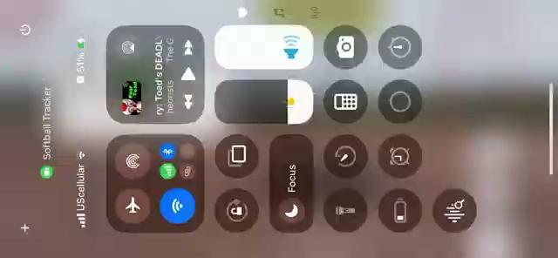
Testing on Thursday
New pushes that were tested:
YOLOv11 model
~30 fps
~22ms inference time
Red dot identifier consistently higher
Standardized YOLO coordinate system
Setup no longer needs marking, we use the model
Place the ball on the home plate
Place the ball at the reference height
Place the ball on the pitcher’s mound
Allows us to avoid translating between Flutter/Image/YOLO coordinate systems
System Arming
Bounding box around pitchers mound
Red/Yellow/Green and triggering tracking
Illegal Logic
Current listener does not trigger when tracking is enabled.

Slide 4
Final Fixes
YOLO red ball marker
When the Yolo model is executed using the iOS CoreML framework, the ball’s x and y coordinates are automatically captured as values between [0, 1]. Currently, the Ultralytics plugin converts these coordinates back to pixels based on an assumed aspect ratio. Instead we could pass the x and y values directly to our screen, which calculates height, and then scale the ball’s position to fit our screen dimensions.
UI Fixes
Overflowing widgets
Update instructions page
Illegal logic listener
When ‘tracking’ is triggered to True, listener must collect and analyze the ball coordinates throughout the pitch until a max height is reached.

Slide 5
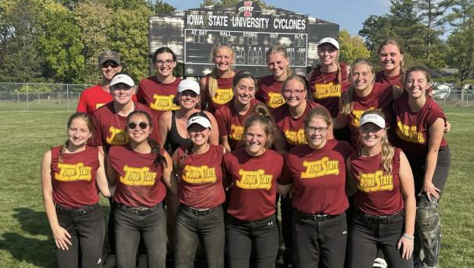
User Testing
Members of the ISU softball club agreed to meet to do user testing.
We will test
How long it takes to set up the app.
Feedback on setup.
Feedback on potential improvements or additions.
Would they use this application?
Iowa State Softball Club

Slide 6
Documentation
Annotated our Fall Design Document for sections still relevant and appropriate for our current application.
User Needs
Requirements
Introduction
Marked sections that need revisions/additions
Executive Summary
Project Plan
Design
Testing
Implementation
Appendices

Slide 7
Final Mentions
IRP Presentation
5/7, Wednesday, 2:20pm
Poster Session
5/7, Wednesday, 3:30pm-5pm

